Slide 1
Localize the Openbravo ERP system into Sinhala language and Implement it with the university system.
Group ID : 16-071

Slide 2
Hardware Interfaces
Software Interfaces
Communication Interfaces

Slide 3
Main Functions…
Human Resources management
Procument management
Student registration management
Examination management

Slide 4
Background of Procurement Management
Purpose
Scope
Reports
Organizational structure of the department

Slide 5
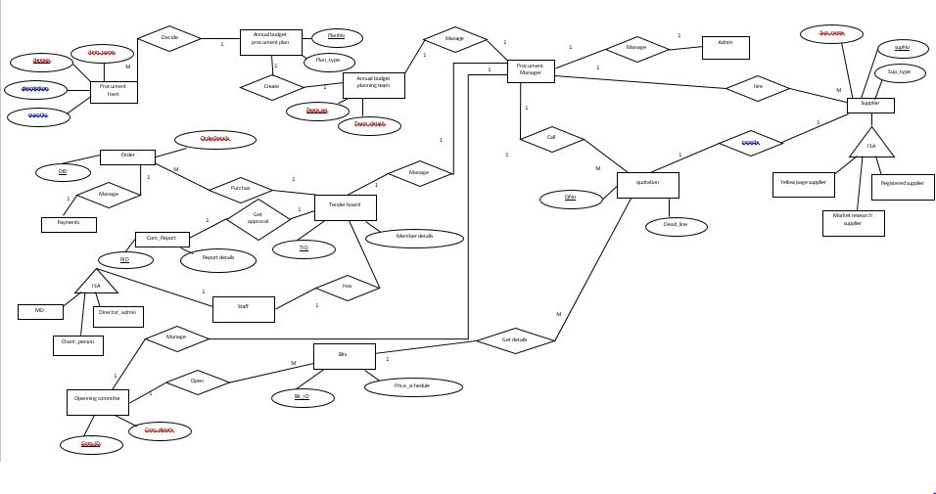
ER diagram for Procument Management

Slide 6
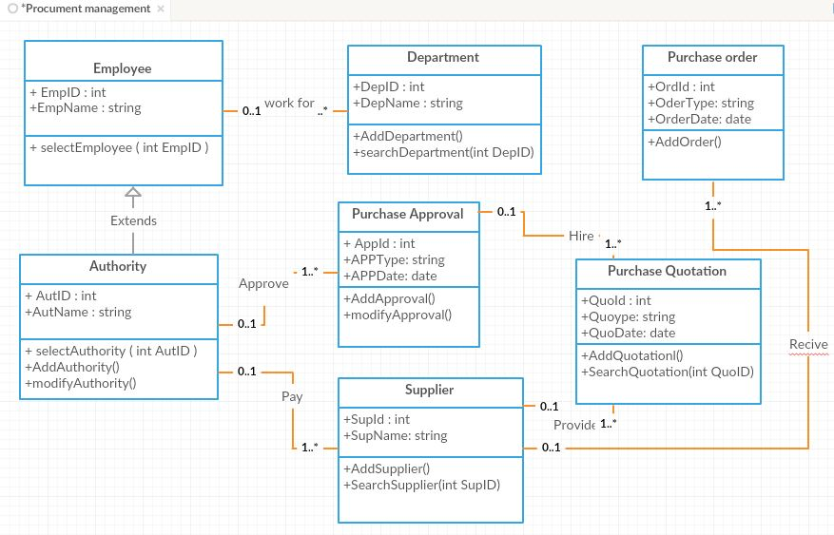
Class diagram for Procument Management

Slide 7
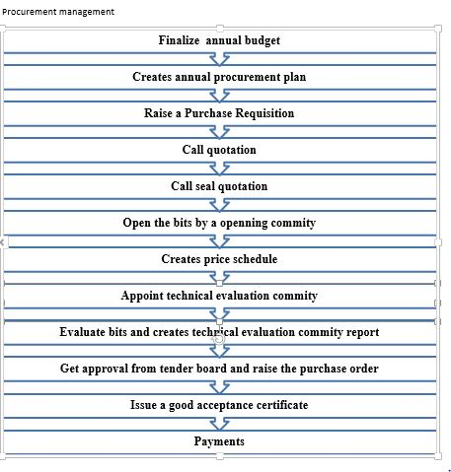

Slide 8
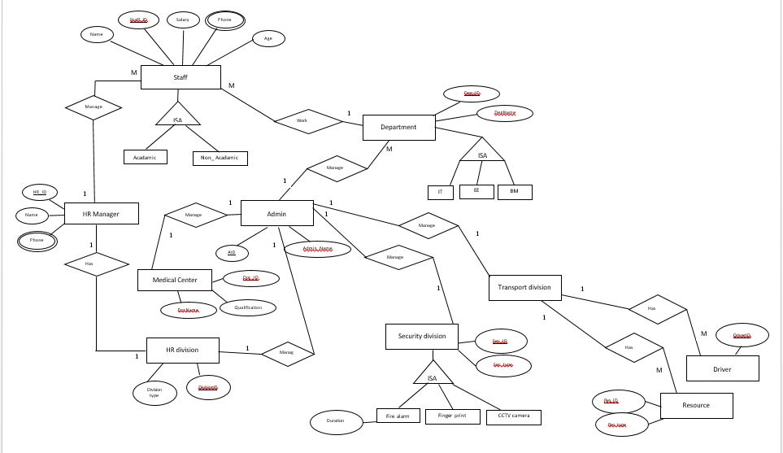
ER diagram for HR Management

Slide 9
Background of HR Management
Purpose
Scope
Reports
Organizational structure of the department

Slide 10
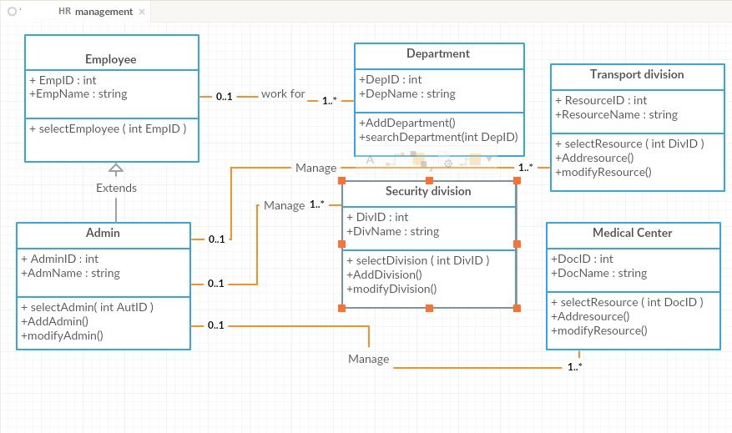
Class diagram for HR Management

Slide 11
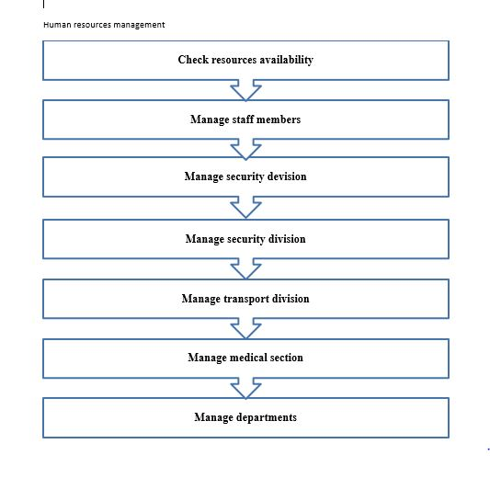

Slide 12
Background of Student Management
Purpose
Scope
Reports
Organizational structure of the department

Slide 13
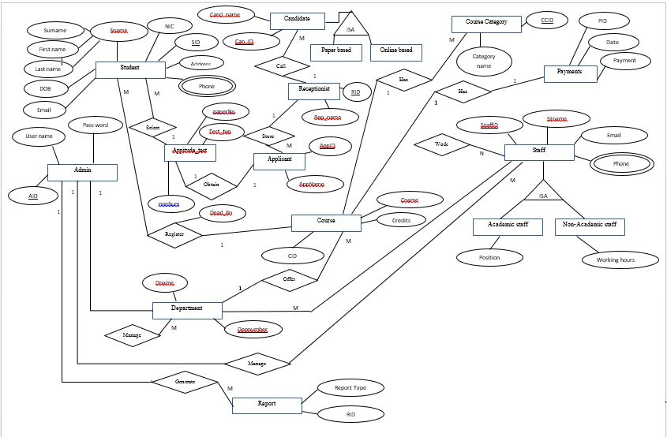
ER diagram for Student registration management

Slide 14
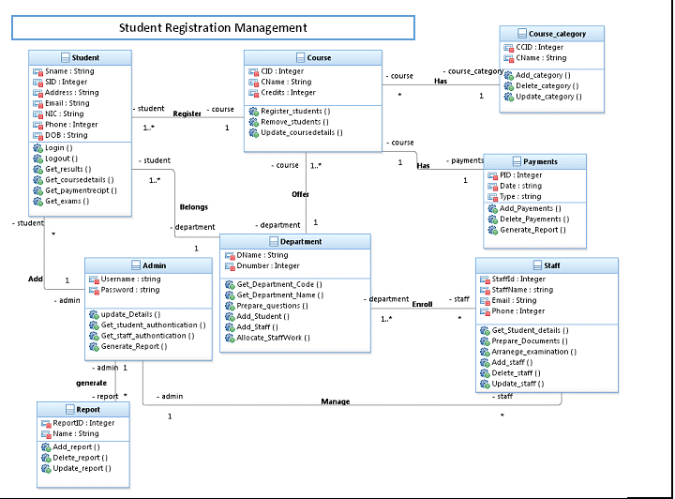
Class diagram for Student registration management

Slide 15
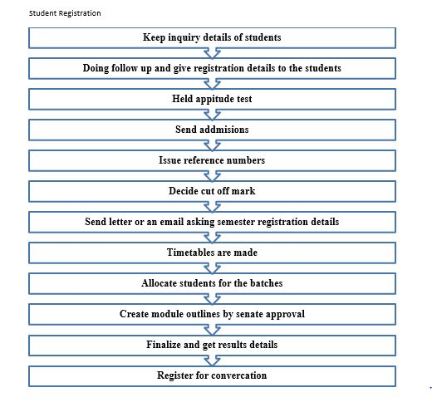

Slide 16
Background of Examination Management
Purpose
Scope
Reports
Organizational structure of the department

Slide 17
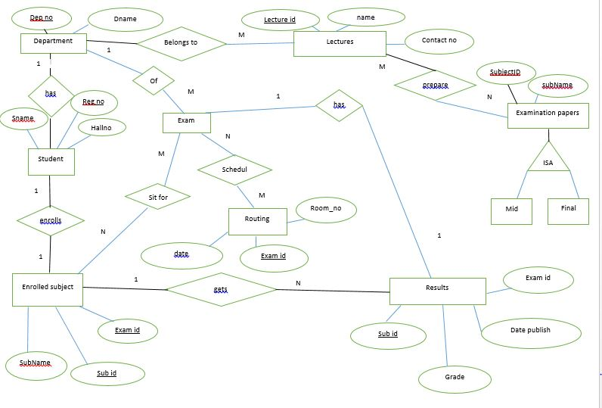
ER diagram for Examination management

Slide 18
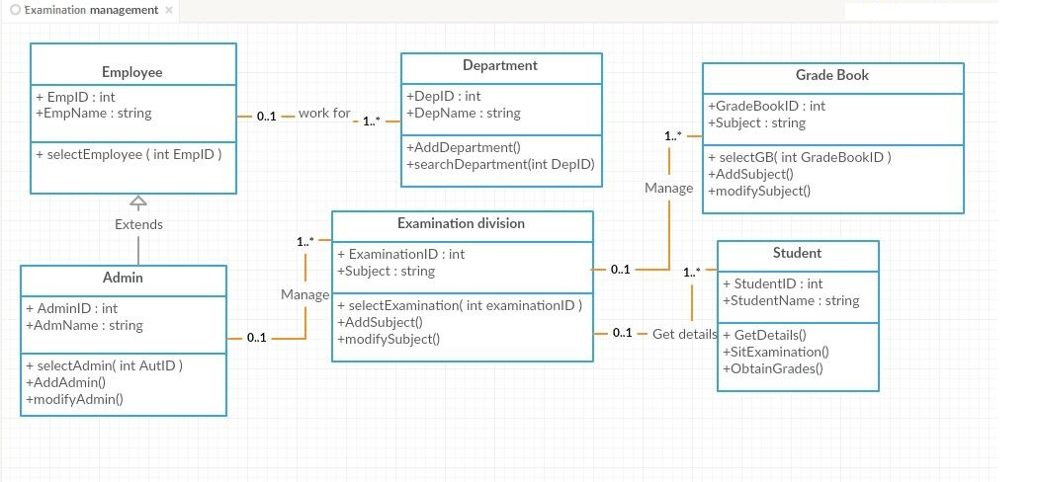
Class diagram for Examination management

Slide 19
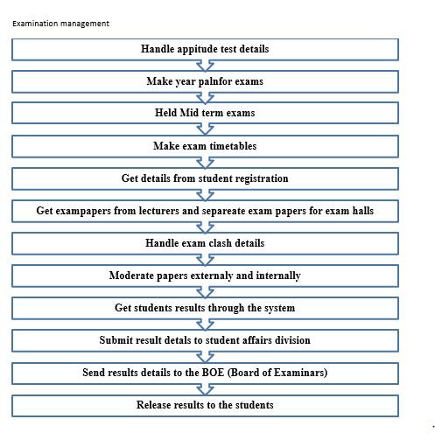

Slide 20
Thank you …..

